Slide 1
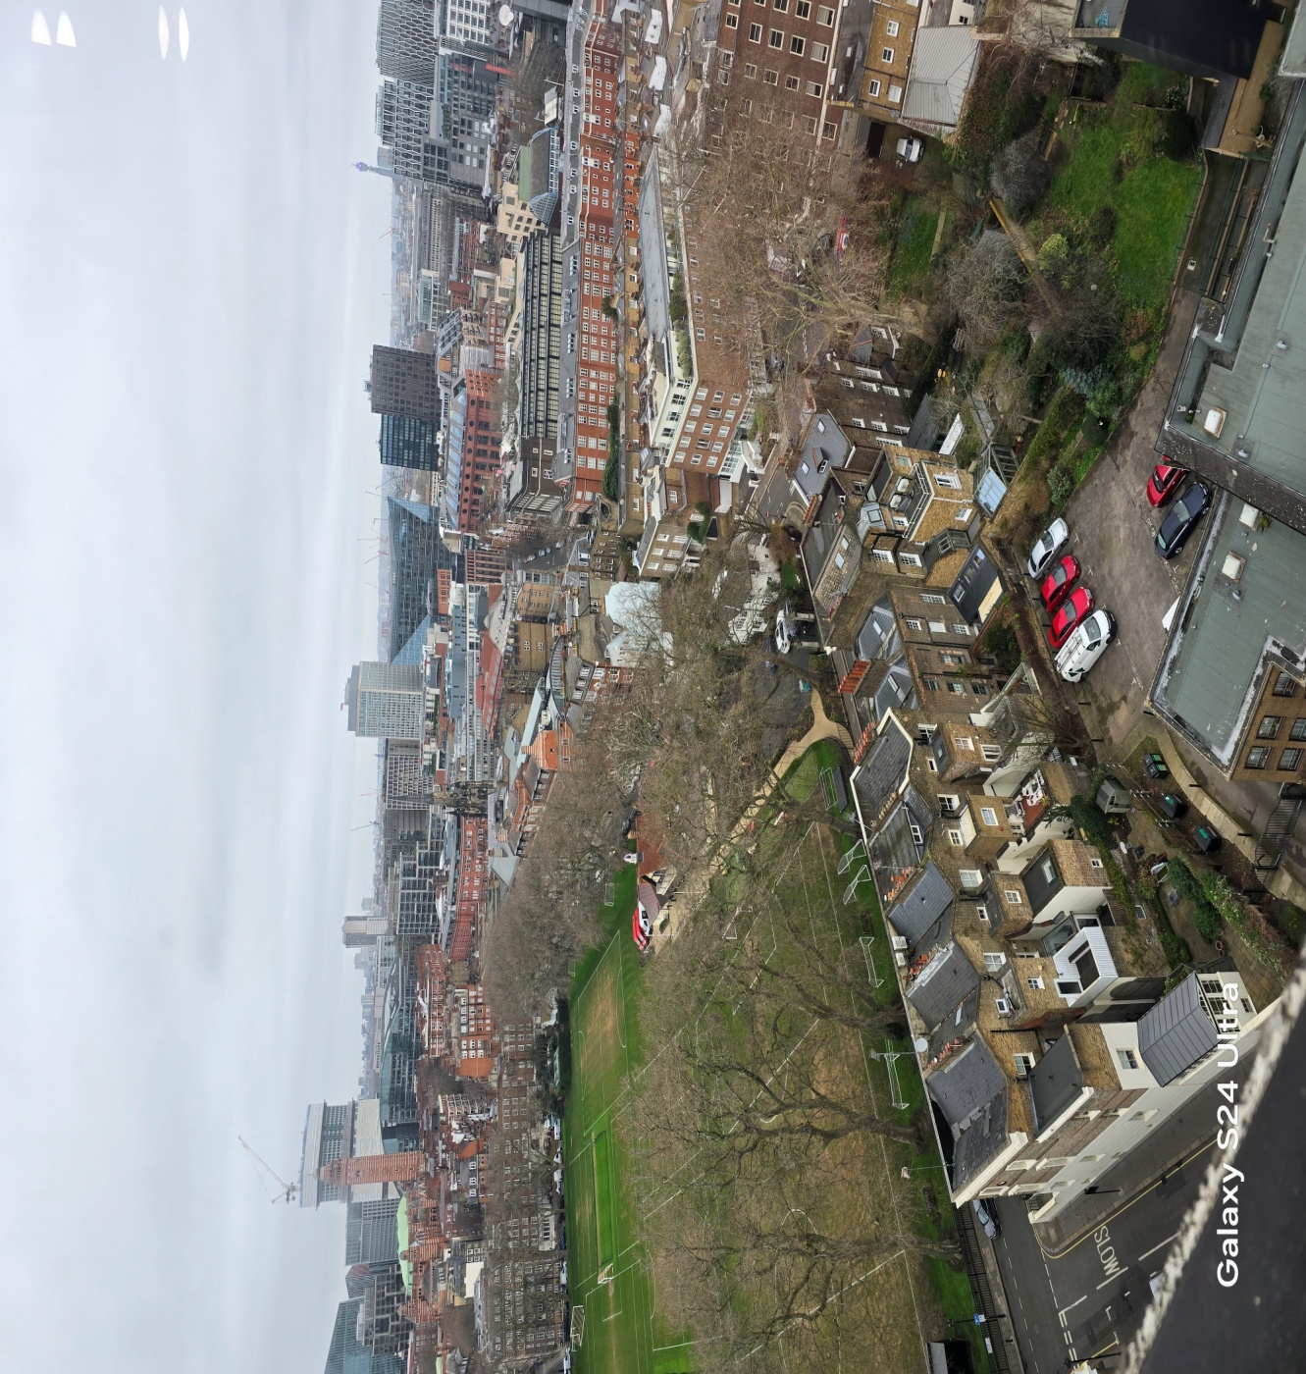
Vincent square
17/03/2026
An update for the Vincent Square Residents Association
PS Ronnie Henderson / PC Tom Warburton / PC Matthew Davies / PCSO Simon McGregor-Wood / PC Shaun Mangat/ PCSO Alex Bird
Notes:
Full Compliment

Slide 2

Visit: www.metengage.co.uk Why sign up? When you join Met Engage, you’ll receive: - alerts about local crime, incidents and appeals - advice to help keep you, your family and your community safe - news from your local police officers - warnings about scams and frauds - invitations to community meetings and events - chances to share your concerns and help shape local policing

Slide 3
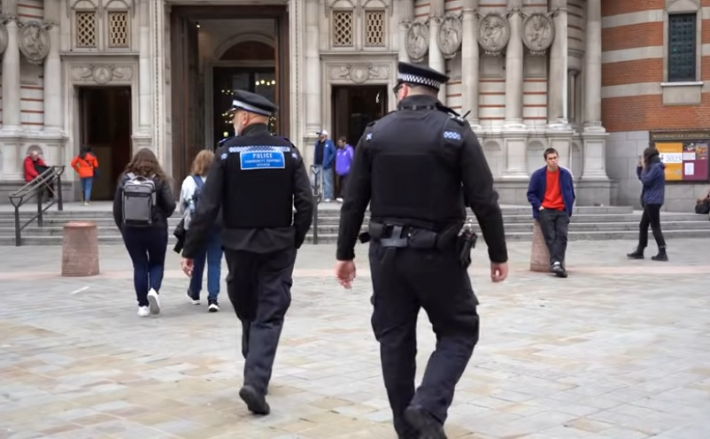
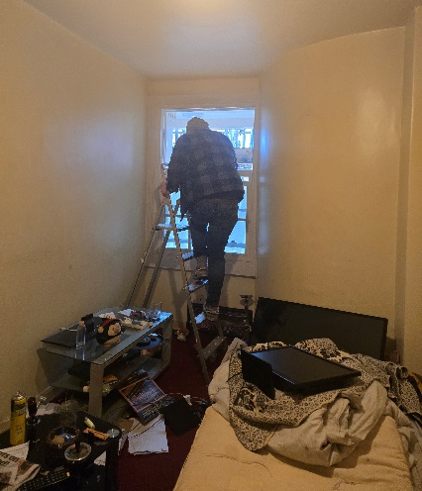
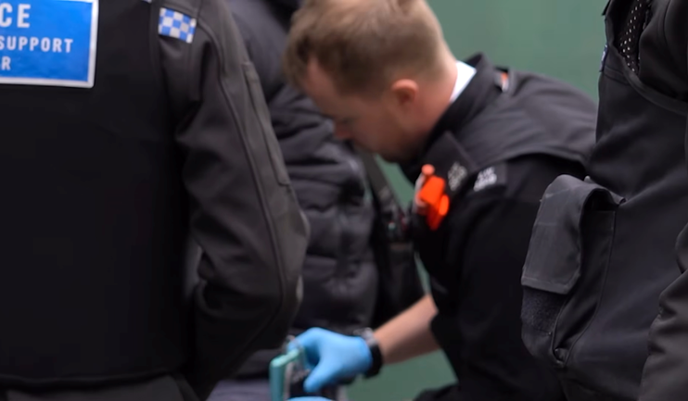
Ward officers have continued a high rate of stop & searches and arrests – focusing on locating and arresting wanted offenders on the street. Officers have also arrested several dealers in the Victoria area. - 6 BOB/FTA - 8 arrests for drug related offences Live facial recognition operation on Victoria Street in January resulting in 7 arrests Officers conducted a closure of a highly problematic property regarding Anti-social behaviour. During the closure of the property officers arrested an individual for PWITS Class A. During a further search of the property stolen items, drugs, ~£3000 in cash and equipment commonly used for drug dealing was seized. Two closure orders on properties involved in heavy ASB are at consultation stage. Officers will be seeking a court date for their closure later this month. Early morning search warrants were executed concurrently on two separate properties. This resulted in the seizure of drugs and a large machete.
Results
Notes:
Monthly crime figures:
April- 136
May- 162
June- 181
July- 178
August- 154
September- 120

Slide 4
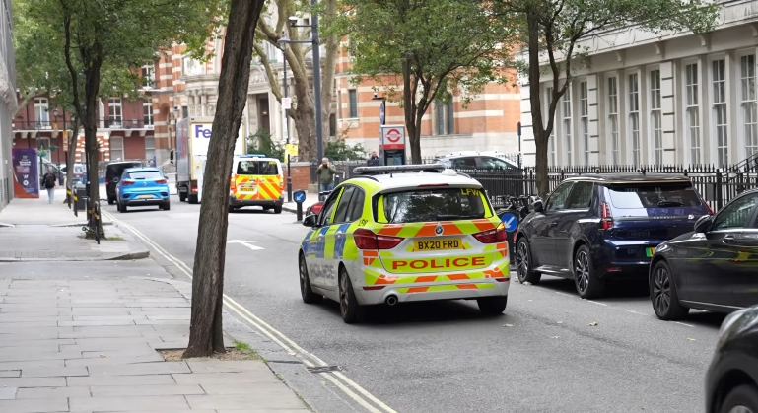
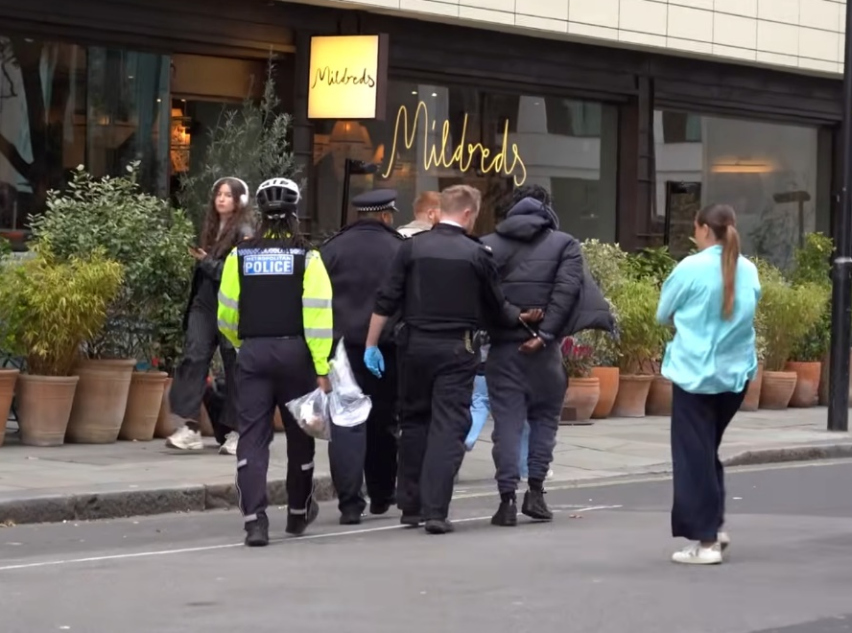
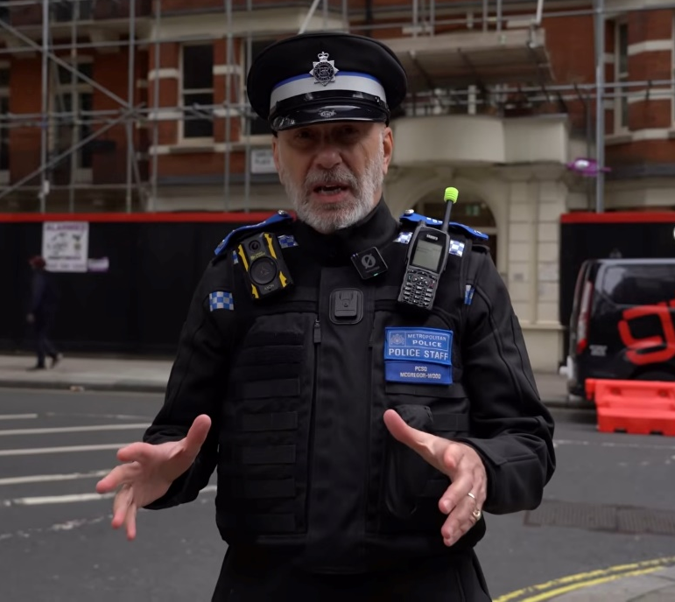
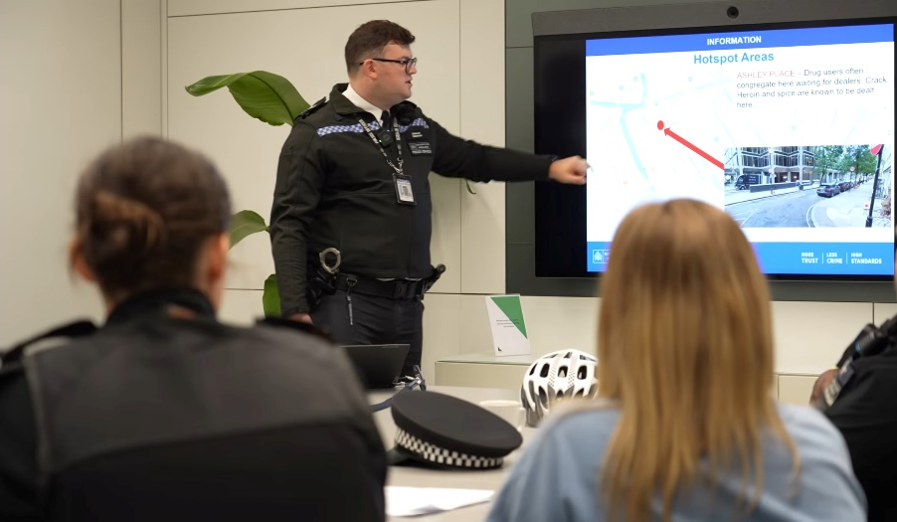
Operation Varenna An operation set up to tackle the drug related anti-social behaviour around Westminster Cathedral and surround residential streets. This involves deployment of officers to the area on key ‘action days’ on both high visibility patrols as well as plain clothes deployments. This also includes co-deploying with partners in Westminster City Council, LHQ BID, My Local Bobby etc So far this has resulted TSG and other police units being deployed to the area outside of the times typically patrolled by ward officers. More officers on the street have had a significant impact on the drug dealing at local level.
Results
Notes:
Monthly crime figures:
April- 136
May- 162
June- 181
July- 178
August- 154
September- 120

Slide 5
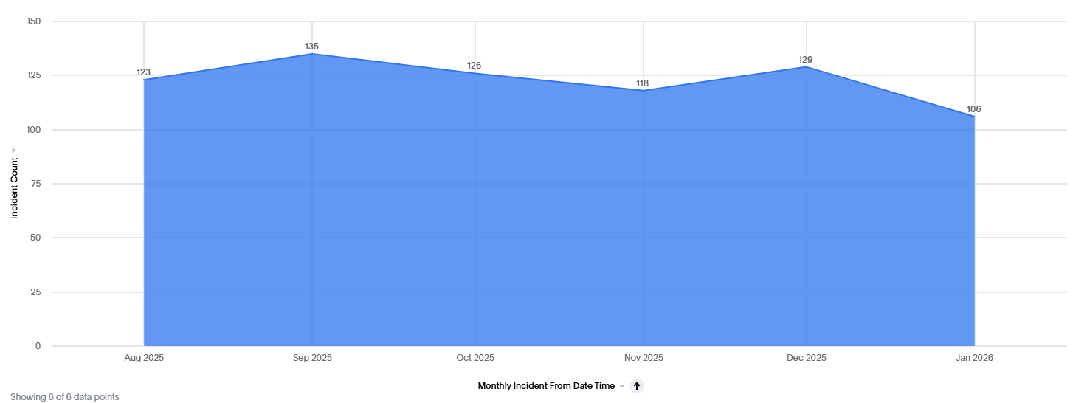
Total Number of Offences - Last 6 Months

Slide 6
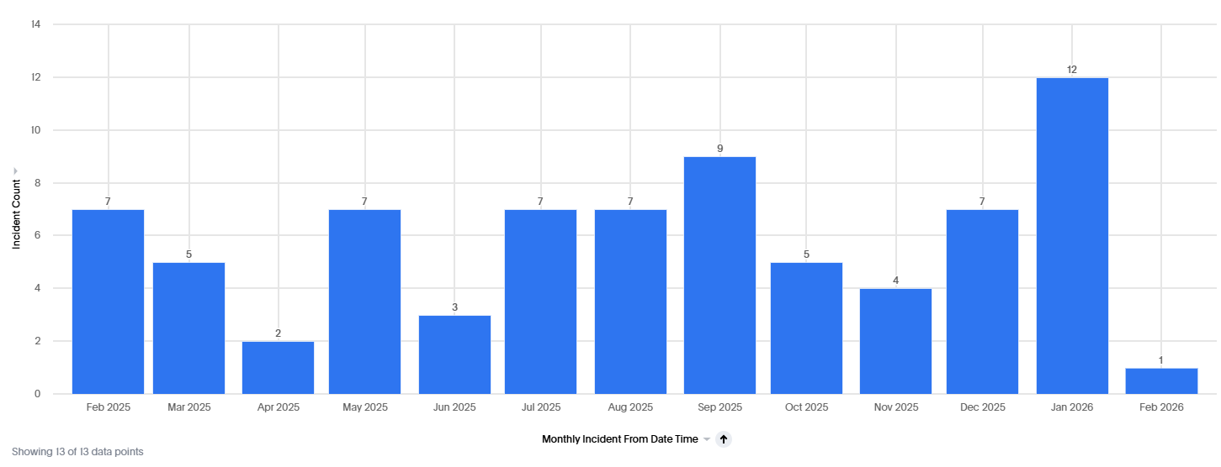
All Drugs Offences - Last 365 Days

Slide 7
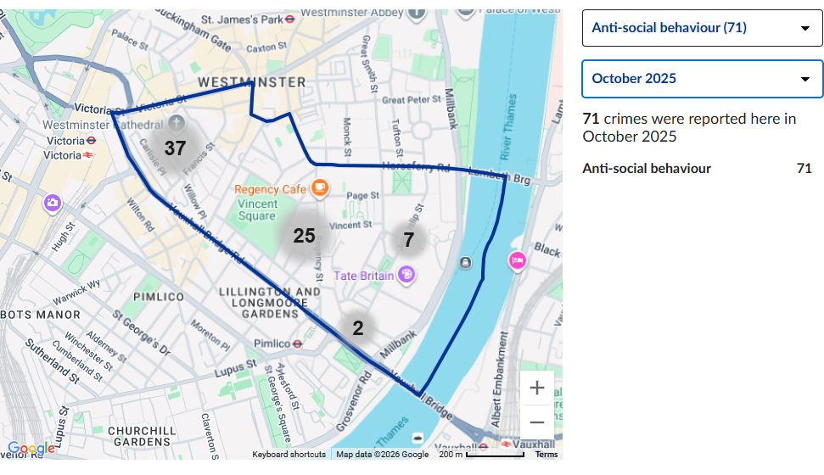
Anti Social Behaviour Heat Map October 2025

Slide 8
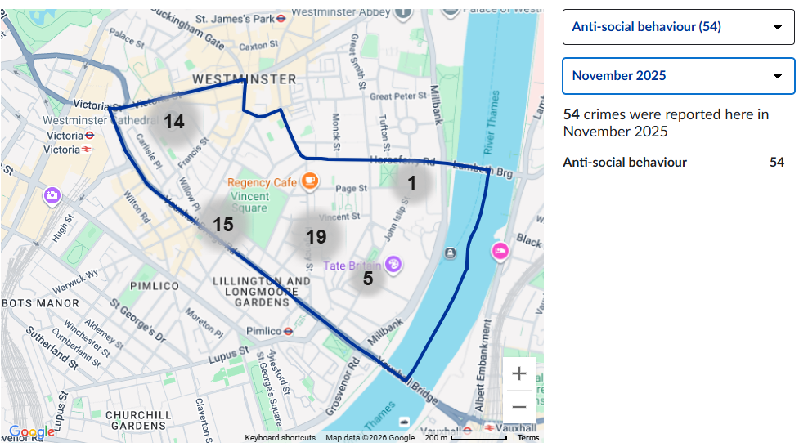
Anti Social Behaviour Heat Map November 2025

Slide 9
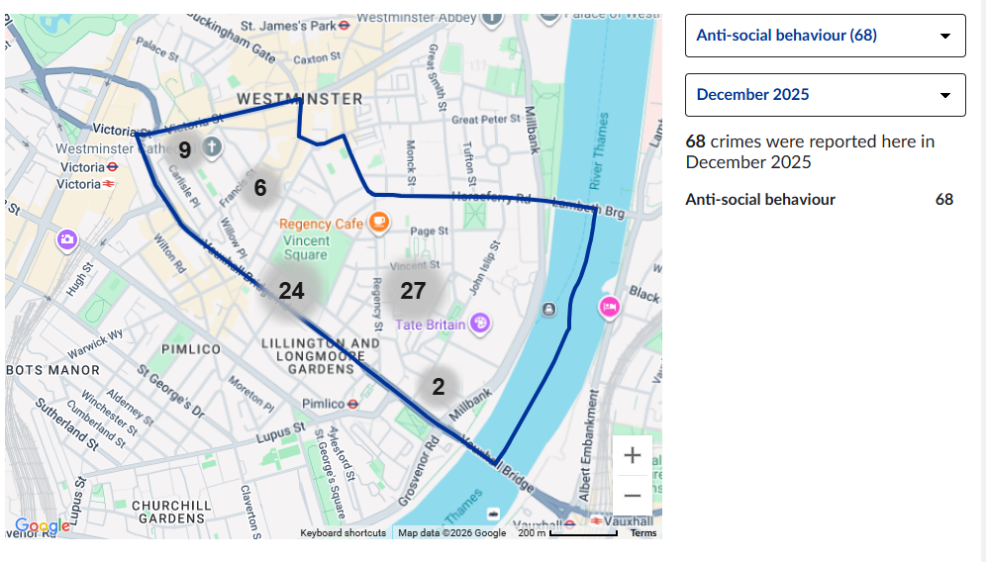
Anti Social Behaviour Heat Map December 2025

Slide 10
Forthcoming
Further Days Of Action tackling ASB & criminality around Westminster Cathedral / Victoria Street
Reassurance Patrols around places of worship continue
Working with Housing / WCC & partners to enforce a Closure on known drugs premises
Planned patrols with council & neighbouring wards to deal with our hotspot areas
Resuming plain clothes work to tackle the drug issue in Victoria.
Community engagement events. Working with residents to discuss crime prevention advice, ways to report crime etc.
ASB Surgeries Continue
Attend court to issue Criminal Behaviour Orders on our top nominals.

Slide 11
Useful Contacts
Crime Stoppers:
0800 555 111
https://crimestoppers-uk.org/
Westminster City Council Street Cleaning Team:
020 7641 2000
https://www.westminster.gov.uk/report-it
Confidential Victim Support:
0808 1689 111
Westminster City Council Noise Team:
020 7641 2000
https://www.westminster.gov.uk/report-it
Action Fraud:
030 0123 2040
https://www.actionfraud.police.uk/
Metropolitan Police Crime Prevention:
https://www.met.police.uk/cp/crime-prevention/
www.met.police.uk / www.metengage.co.uk
101 OR 999 in Emergencies
You can follow us on; https://twitter.com/MPSVincentSq

